Slide 1
Introduction to SQL

Slide 2
Learning Outcomes
By the end of this unit, you will be able to:
Create a data model to represent the objects and relationships in a dataset.
Create schemas, tables, and databases for relational data.
Retrieve data using advanced database queries.

Slide 3
Class Objectives
By the end of today’s class, you will:
Install PostgreSQL and pgAdmin on your computer.
Create databases and tables using pgAdmin.
Define SQL data types, primary keys, and unique values.
Load CSV files into a database.
Query data from a database.
Articulate the four basic functions of CRUD and apply them to a database.
Combine data from multiple tables using JOINs.

Slide 4
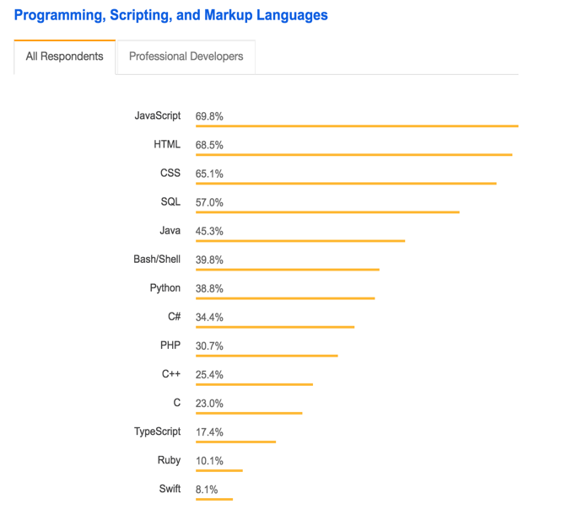
Why SQL?
Structured Query Language (SQL) is one of the main query languages used to access data within relational databases.
SQL is designed to efficiently handle large amounts of data, resulting in high value to organizations.
Experienced SQL programmers are in high demand.
Image from the Stack Overflow 2018 Survey

Slide 5
Postgres and pgAdmin

Slide 6

Postgres
PostgreSQL (usually referred to as "Postgres") is an object-relational database system that uses the SQL language.
Database engine
Open source
Great functionality

Slide 7
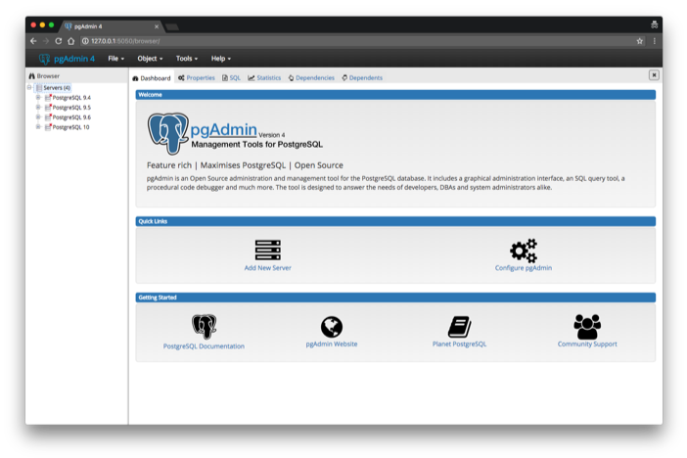
pgAdmin
pgAdmin is the management tool used for working with Postgres.
It simplifies creation, maintenance, and use of database objects.

Slide 8
CRUD

Slide 9
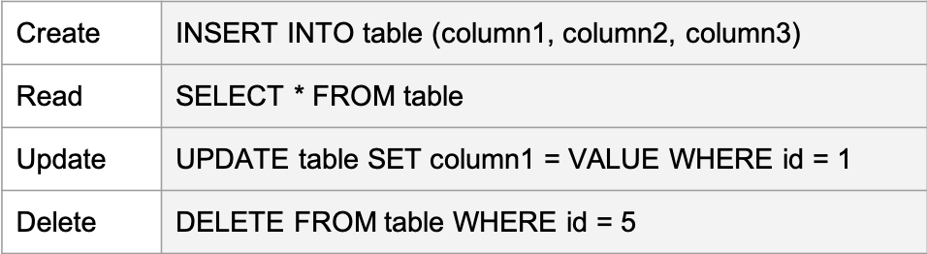
CRUD Operations
Create Read Update Delete is a set of operations used with persistent storage.
These tools are fundamental to all programming languages, not just SQL.

Slide 10
Wildcards

Slide 11
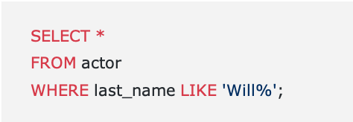
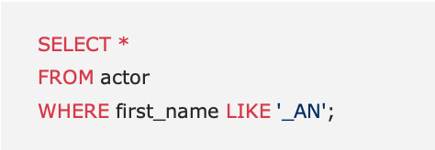
Wildcards: % and _
Wildcards are used to substitute zero, one, or multiple characters in a string.
The keyword LIKE indicates the use of a wildcard.
The % will substitute zero, one, or multiple characters in a query.
For example, all of the following will match: Will, Willa, and Willows.
The _ will substitute one, and only one, character in a query.
_AN returns all actors whose first name contains three letters, the second and third of which are AN.

